Slide 1


NLBStarterKit using Raspberry Pi Pico 2W
Powered by Raspberry Pi
Disclaimer: NOT CONNECTED TO NLB or Pi Python LXC

Slide 2
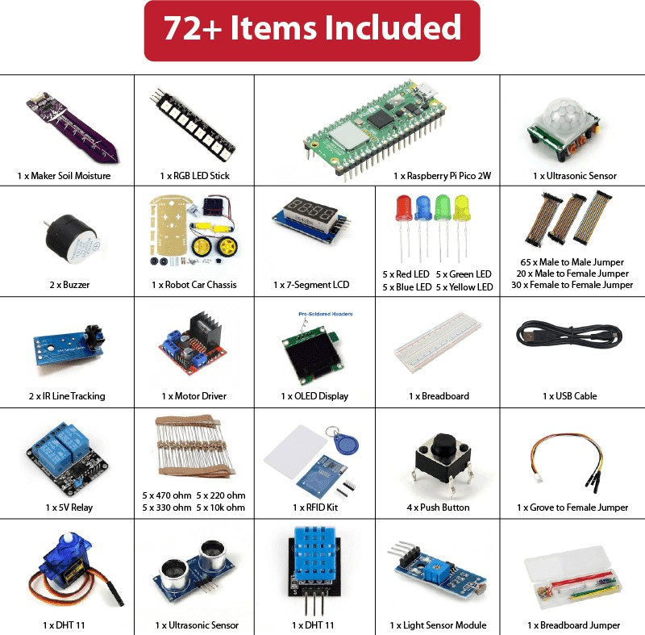
KIT Include:
$71.07
2 x Micro Servo

Slide 3
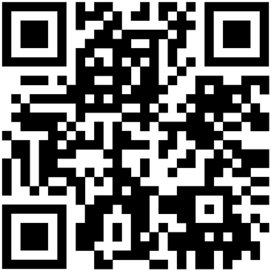
Explore the NLB Maker Kit !
Item Code: KIT-PICOW-MKR
Disclaimer: NOT CONNECTED TO NLB or Pi Python LXC
NLBKITSPECIAL1225
Get Discount with code NLBKITSPECIAL1225
Scan now :
Don’t forget to use the code at checkout!

Slide 4
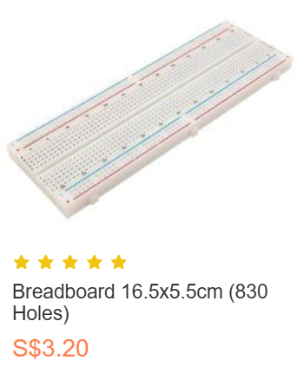

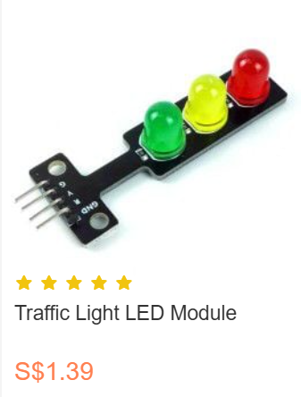
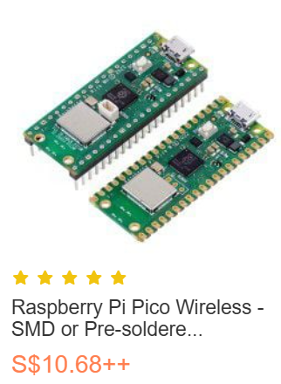
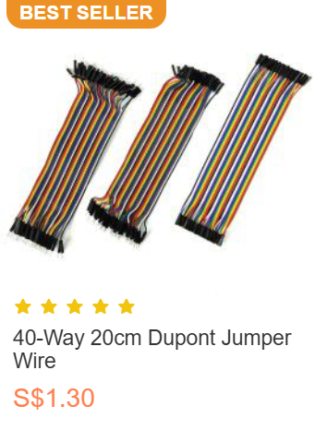
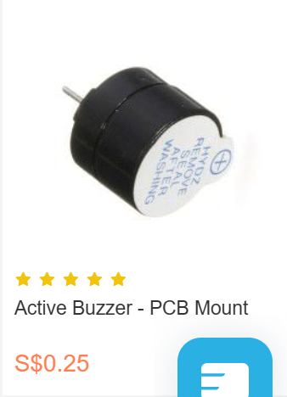
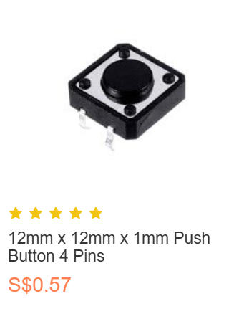
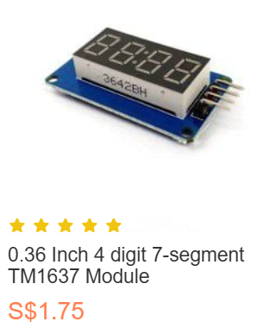
Pre-soldered
Male-Male
Male-Female
Resistors Order from Shopee/Lazada (1000-2000 ohms)

Slide 5
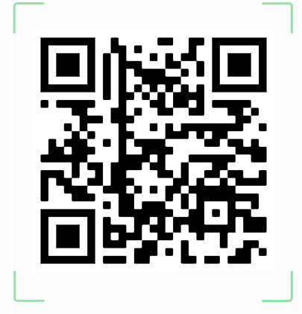

Slide 6
Joining Pi Makers Club
Whatsapp your name to me
@ 91080064
Coming meeting :
10 August 2025
12:00 – 14:30
TRL – Makers Space

